Slide 1
ARDIAN PRESENTATION
Columbia Capstone Group 32

Slide 2
PART 1. LITERATURE REVIEW
1.1 Relevant Literature on Market Segmentation & Cluster Analysis
(1) Basis for Segmentation
- Demographic Segmentation: Divide the market based on variables such as age, gender, income, education, and family size.
- Geographic Segmentation: Segmentation based on location, eg. countries, states, cities, or neighborhoods.
- Psychographic Segmentation: Divide the market based on social class, lifestyle, or personality characteristics.
- Behavioral Segmentation: Segmentation based on consumer knowledge, attitudes, uses, or responses.
(2) Potential Types of Clustering Methods
- Hierarchical Clustering: Create a tree-like structure of clusters, can be either agglomerative (bottom-up) or divisive (top-down).
- K-means Clustering: Create 'k' clusters are by minimizing the variance within each cluster.
- DBSCAN (Density-Based Spatial Clustering of Applications with Noise): Useful for identifying clusters of arbitrary shapes and for handling noise and outliers.
(3) Cluster Numbers and Validation
-Determining Number of Clusters: Methods including Elbow Method, Silhouette Method, and Gap Statistic.
- External Validation: Assess stability and reliability of the clusters through methods like cross-validation.
- Internal validation: Use measures like the Silhouette Coefficient, Dunn Index, and within-cluster sum of squares.
(4) Advanced Techniques and Trends
- Integration of Machine Learning Algorithms for more efficient and sophisticated clustering.
- Big Data Analytics to incorporate a wider range of variables, including structured data such as transaction records and unstructured data like social media activity and online behavior.
- Predictive Analytics to forecast future consumer behaviors and segment movements.
- Potential impact of advancements in AI and machine learning on cluster analysis techniques.
(5) Challenges and Considerations
- Challenge of Balancing between too many small clusters and too few large, overly generalized clusters.
- Difficulty in Interpreting Clusters and implementing actionable marketing strategies based on them.
- Risk of overfitting: finding patterns in the data that do not generalize well to new data.
- Dynamic Nature of consumer preferences and the market.
- Ethical considerations, especially in terms of privacy and data security.
Michelle Peng

Slide 3
PART 1. LITERATURE REVIEW
1.2 Relevant Literature on Free Toll Revenue Collection
(1) Extent and Impact of Toll Evasion
- Prevalence: Statistical data on toll evasion rate in various regions or specific toll systems. Studies of successful interventions and lessons learned.
- Financial Loss: Analysis of the revenue loss due to toll evasion and its impact on infrastructure funding and maintenance.
(2) Factors Contributing to Toll Evasion
- Technical Issues: Flaws or limitations in toll collection systems..
- Economic Factors: How the economy affects toll collection rates
- Cultural Factors: How societal norms influence toll evasion.
- Psychological Factors: How behavioral economics can explain toll evasion behaviors, including perceived unfairness and convenience.
(3) Technological Solutions
- Implementation of Advanced Technologies like high-resolution cameras, improved RFID systems, and automatic license plate recognition (ALPR).
- Predictive Analytics to identify patterns of evasion and potential evaders.
- Systematic Integration of toll Collection systems with other traffic management and law enforcement systems.
(4) Legislative and Policy Measures
- Stricter Laws and Penalties: Analysis of the impact of increased fines and penalties on reducing toll evasion.
- Policy Interventions: Government initiatives and policies aimed at reducing toll evasion, including public awareness campaigns.
- Incentive Structure Design: Discussion of designing pricing and penalty systems that align with human behavior to reduce evasion.
(5) Public Engagement and Education
- Role of Public Awareness: The importance of educating the public about the consequences of toll evasion and the need for tolls.
- Community Engagement Strategies: Effective ways to involve the community in discussions and decision-making about toll collection and enforcement.
(6) Challenges in Implementing Solutions
- Balancing Security and Privacy: Addressing concerns about surveillance and data privacy in the implementation of advanced monitoring systems.
- Cost-Benefit Analysis: Evaluating the financial feasibility of implementing advanced anti-evasion technologies.
(7) Emerging Technologies and Innovations
- AI and Machine Learning: Potential of these technologies in detecting and preventing toll evasion more effectively.
- Blockchain and Secure Transactions: Exploring how blockchain technology can be used to secure transactions and reduce evasion.
Michelle Peng

Slide 4
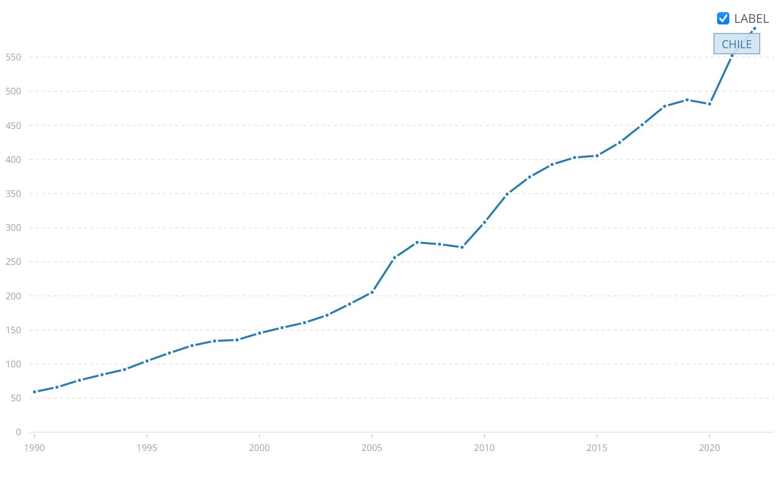
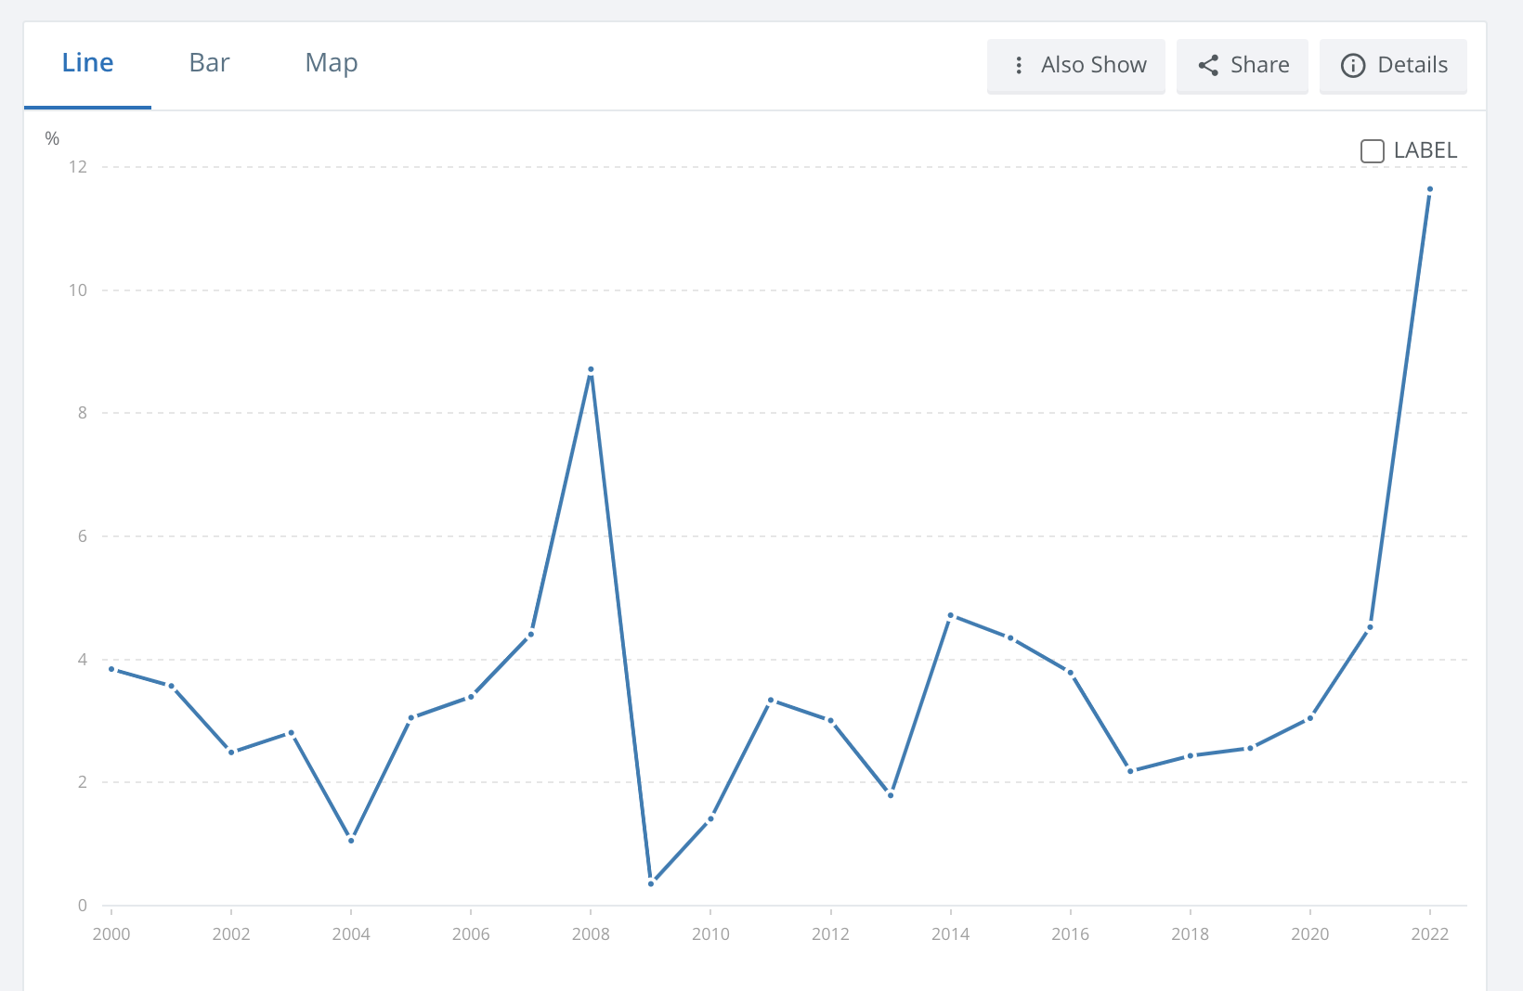
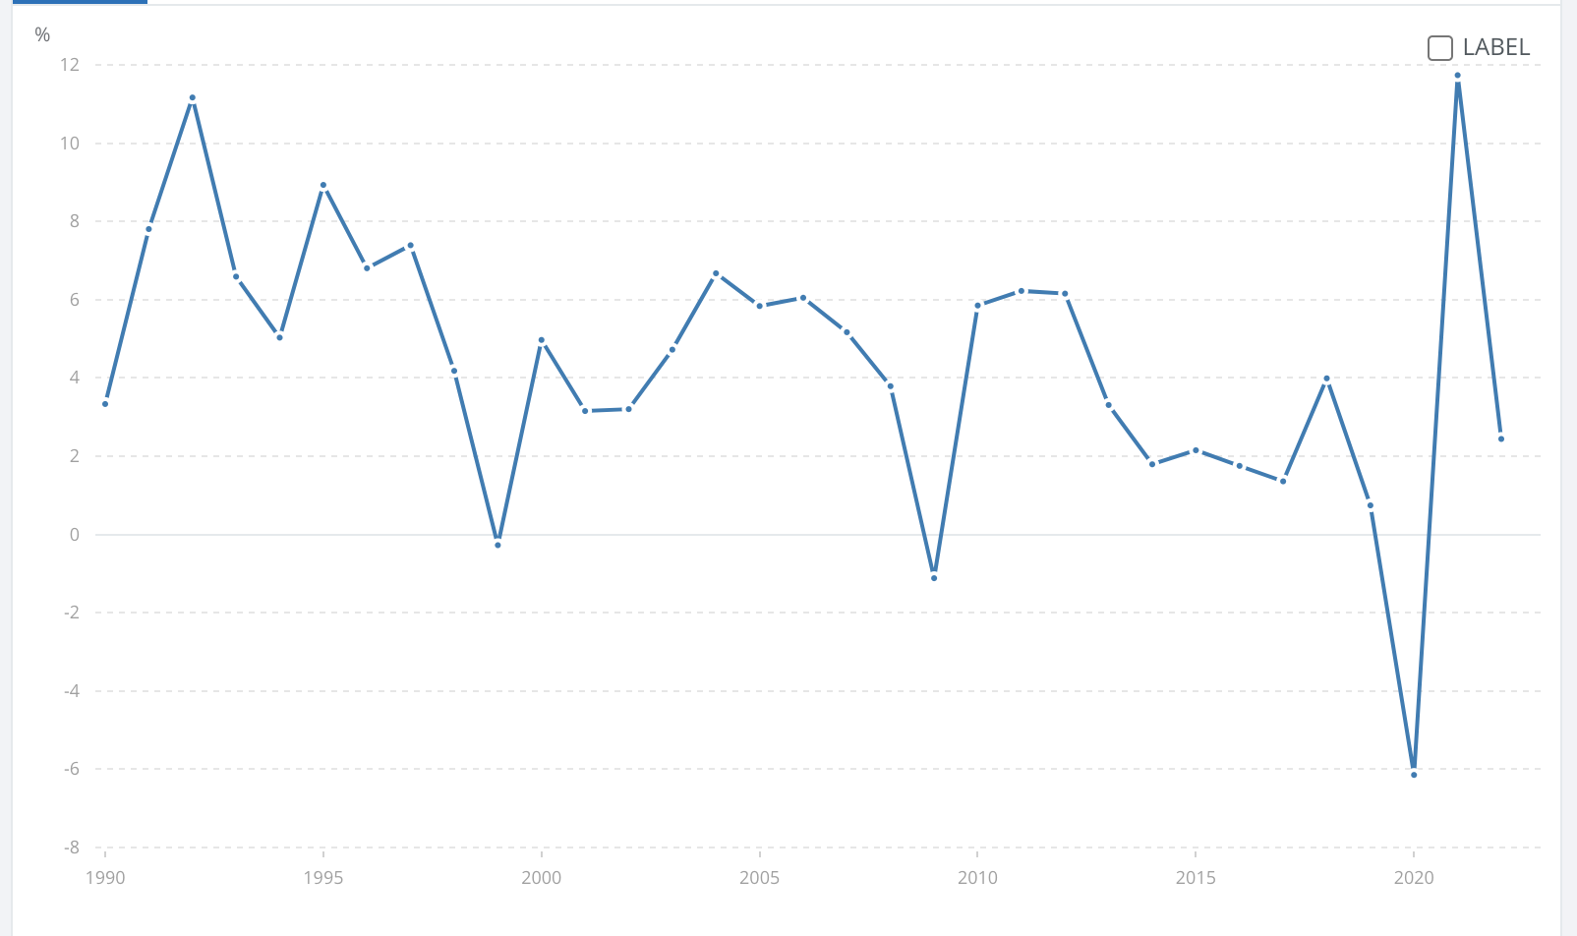
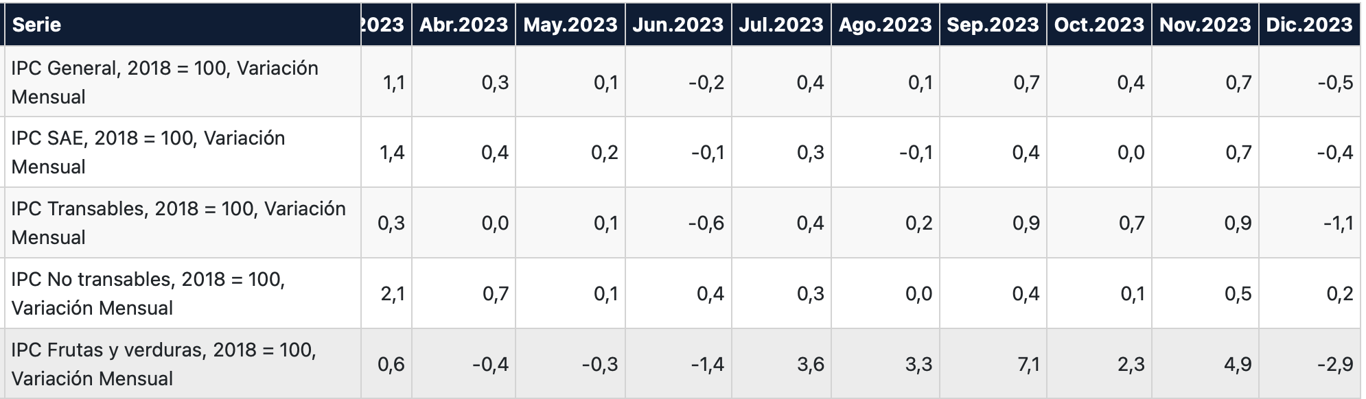
Source: The World Bank, INE
PART 2. OPEN SOURCE MACRO DATA
2.1 GDP Growth
2.2 Inflation (Consumer Price Index)
Chile GDP, PPP (current international $)
Inflation, consumer prices (annual %)
Inflation, consumer prices (annual %)
Potential usage of Inflation (Consumer Price Index):
1. Anticipate changes in costs and consumer behavior
2. Use in financial models to ensure that future revenue streams are evaluated in real terms, accounting for the expected changes of purchasing power
Chile GDP Growth (annual %)
Potential usage of GDP growth data:
1. Segment customers based on their responses to economic conditions
2. Adjust the revenue optimization model to account for expected changes in consumer behavior based on economic forecasts
Kris Chen & Raphael Barthes

Slide 5
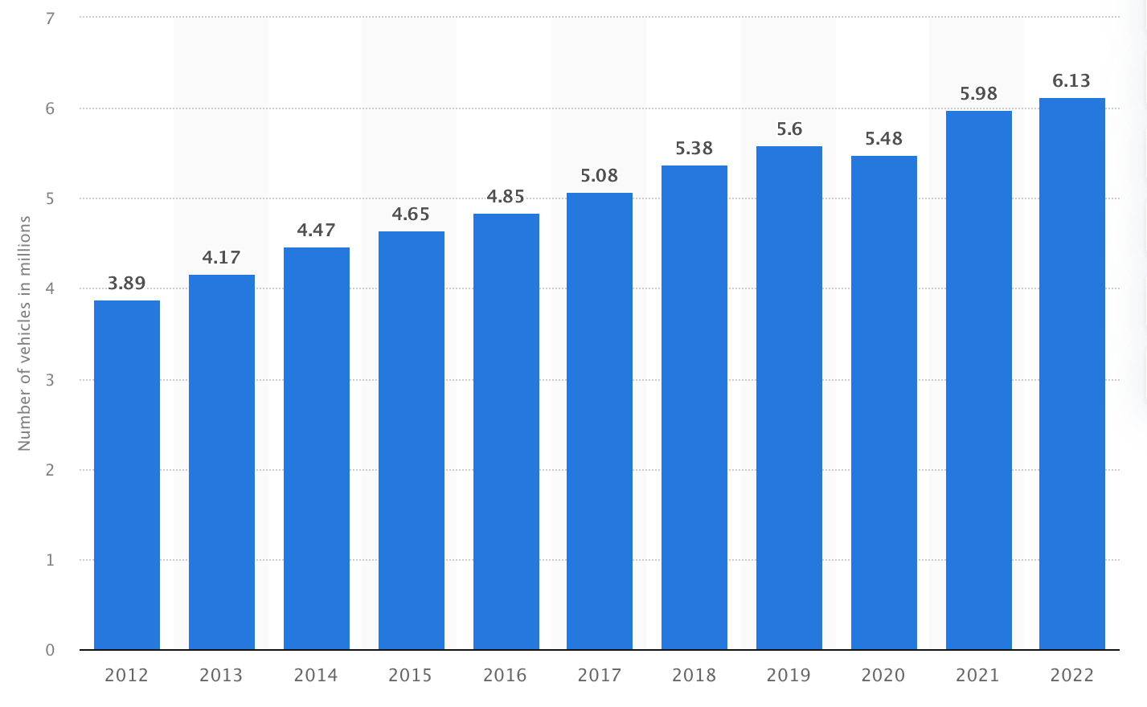
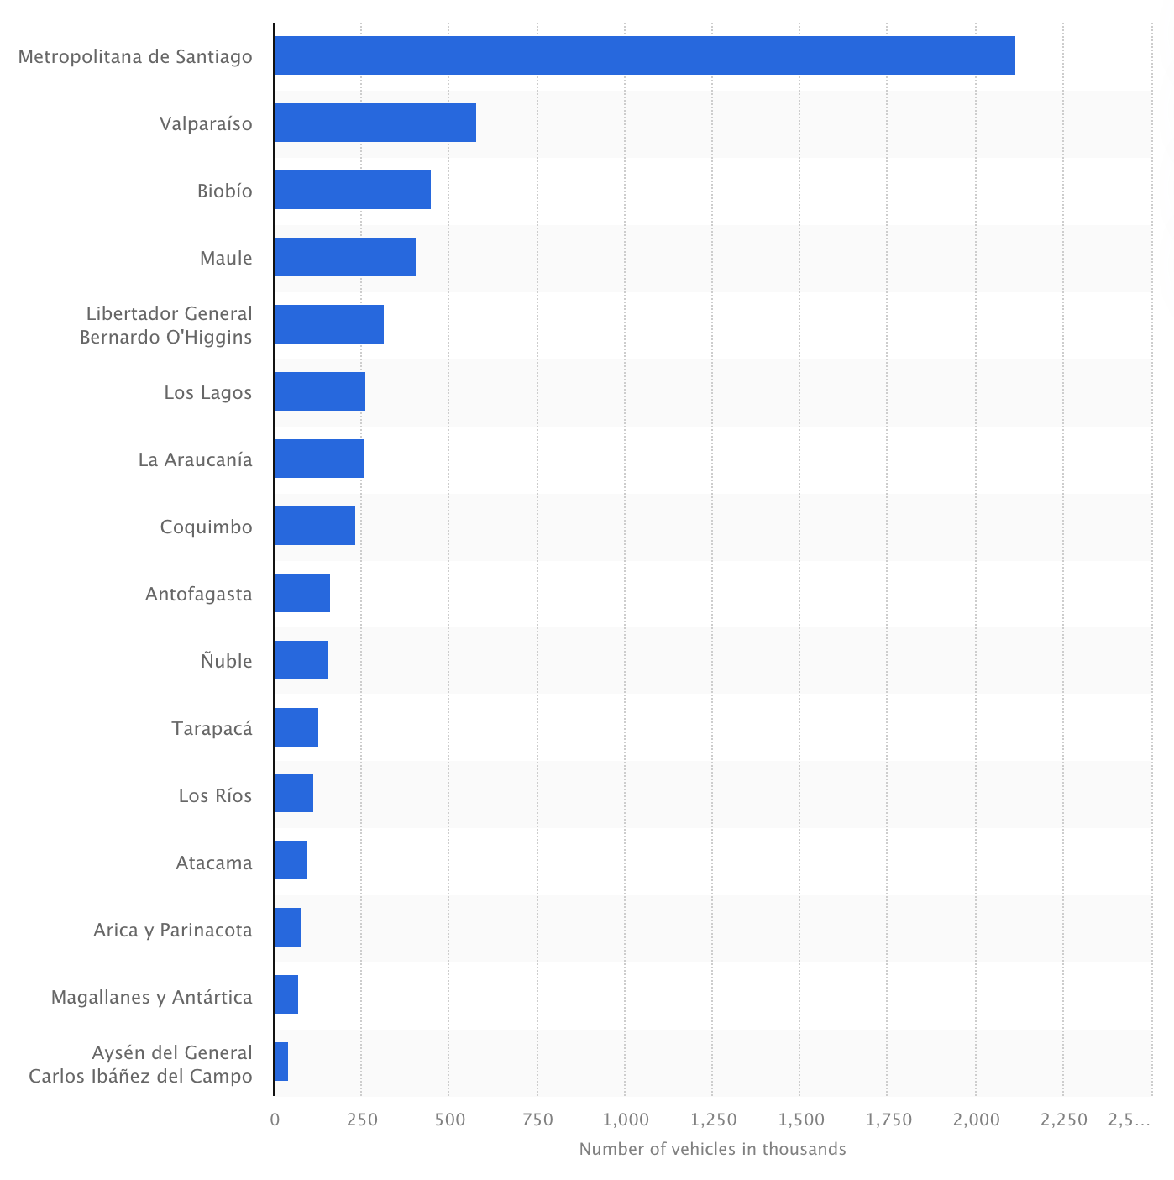
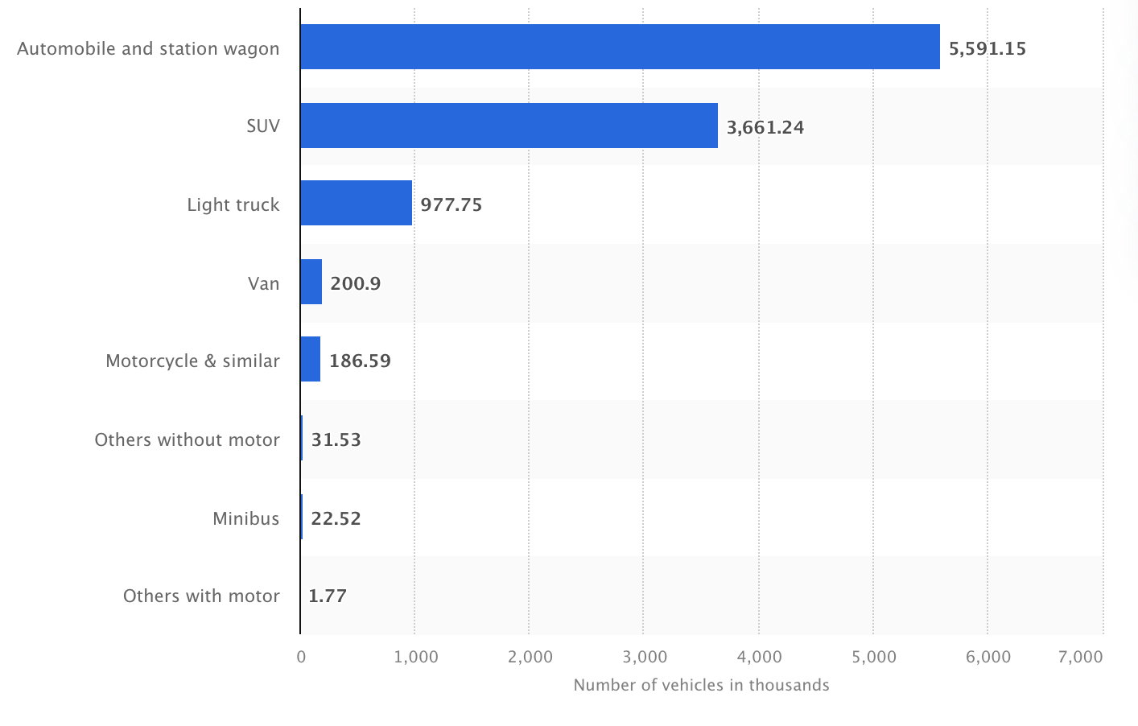
Source: INE
PART 2. OPEN SOURCE MACRO DATA
2.3 Vehicle Fleet / License Plate Aggregated Data
Potential usage of Vehicle data:
1. Refine customer segmentation by inferring lifestyle and spending patterns
2. Regularly analyze vehicle fleet trends to forecast changes in traffic volume and composition
3. Inform infrastructure and technology decisions, focusing on compatibility, efficiency, and user convenience
Number of motor vehicles in circulation in Chile from 2012 to 2022 (in millions)
Number of motor vehicles in use in Chile in 2020, by region
This data can serve as a proxy for several economic and behavioral factors, such as urbanization levels, economic accessibility, and consumer lifestyle choices.
Note: we would need more detail about the vehicle category variable described in the dataset: “Categorias Vehiculos”
Number of private transportation road vehicles in use in Chile in 2020, by type (in 1,000s)
Kris Chen & Raphael Barthes

